Slide 1





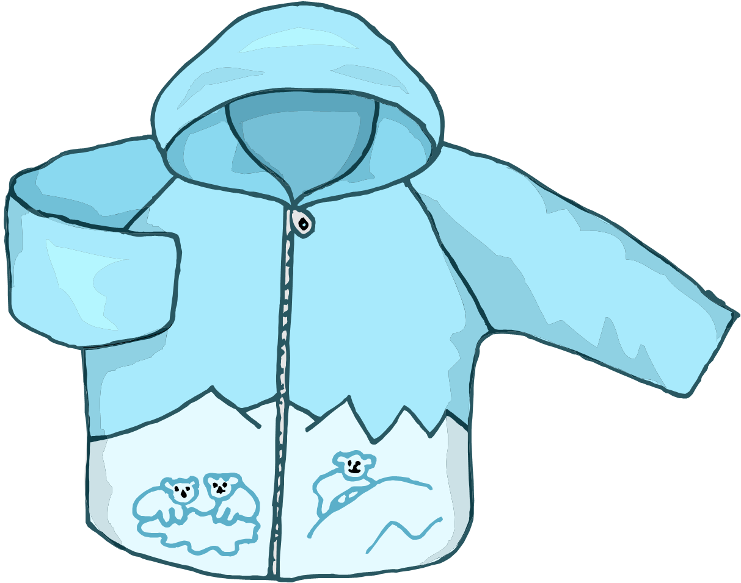







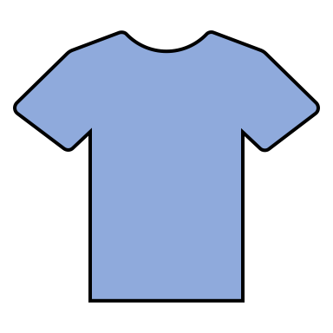



Slide 2



1
2
3
4
5
6

Slide 3



Thank you for downloading this free version of Beach Cariboo! All icons and images came from PowerPoint Microsoft 365.
This download is intended for the sole use of the person downloading. Please do not redistribute, reproduce, or sell this material. Please direct others interested back to the original source.
Enjoy!
-Michelle
Did you like this material? Follow my blog for more therapy ideas! www.michellenin.com/blog
Follow me on Instagram! @SLP.in.CLE

